Slide 1

IPL DATASET ANALYSIS
Gowtham S
DA & DS
Feb-25

Slide 2
Agenda
Introduction
Data Cleaning
Exploratory Data Analysis
Data Preprocessing
Before Model Implementation
After Model Implementation
Key Insights
Conclusion

Slide 3
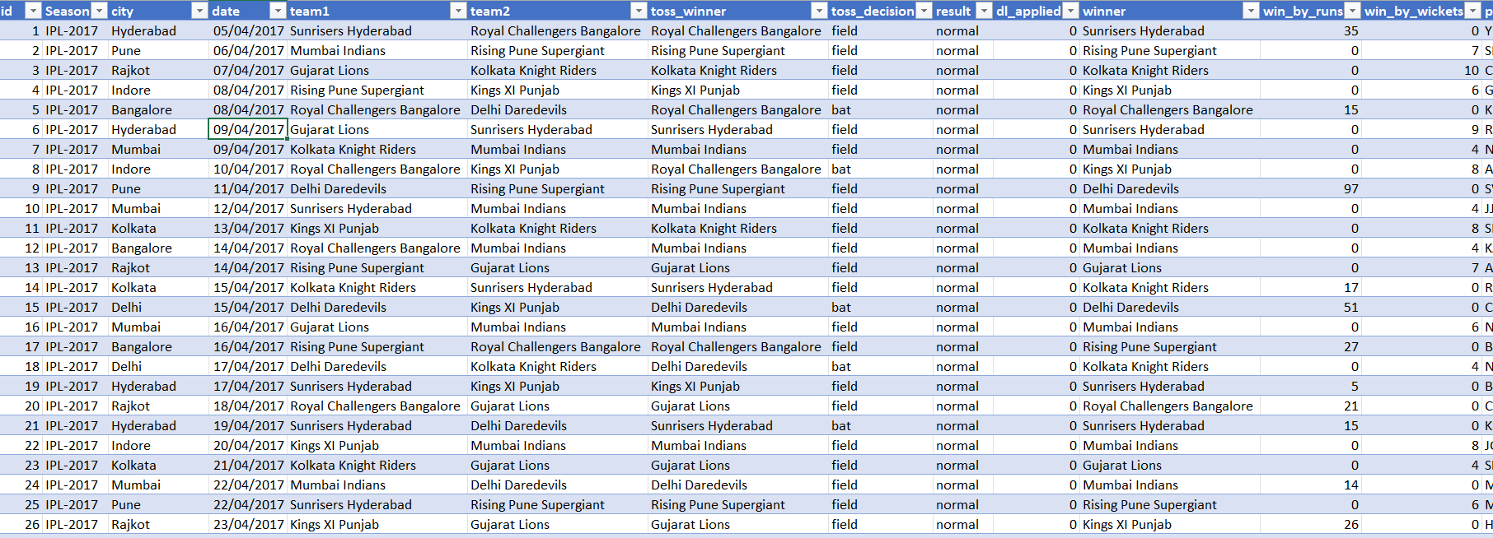
INTRODUCTION
756 IPL match records from 2008 to 2019
Key Columns : (team1, team2, toss winner, toss decision, city, venue, win by runs, win by wickets, winner)

Slide 4
DATA CLEANING
Removed unwanted columns
Date format Change
Fill the blanks in city column
Drop Umpire1, Umpire2, Umpire3
Replace Incorrect Spellings

Slide 5
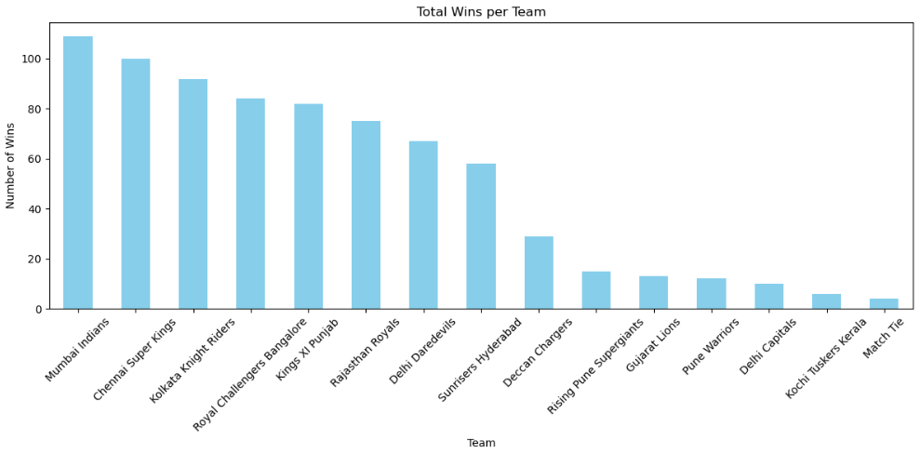
EDA

Slide 6
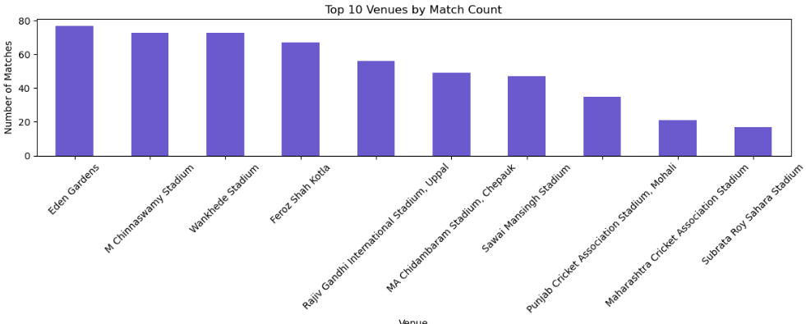
Most of Matches

Slide 7
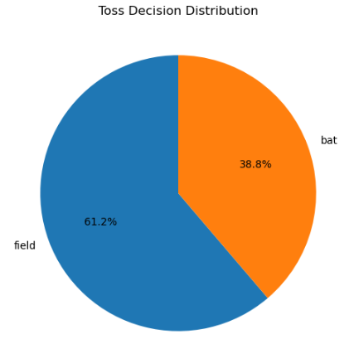
Toss Decision

Slide 8
Data Preprocessing
X as an Other Columns
Y as an Winner column
Train Test split – 80% Train , 20% for Test
Scaling – Standard scalar
Label encoding for numerical categories

Slide 9
Before Model Implementation
Model | Testing Accuracy | Training Accuracy
XG Boost | 0.53 | 0.88
Decision Tree | 0.55 | 0.89
KNN | 0.44 | 0.67
SVM | 0.53 | 0.81
Logistic Regression | 0.51 | 0.80
Random Forest | 0.53 | 0.89

Slide 10
After Model implementation
Model | Testing Accuracy | Training Accuracy
XG Boost | 0.89 | 0.93
Decision Tree | 0.91 | 0.93
KNN | 0.94 | 0.95
SVM | 0.94 | 0.94
Logistic Regression | 0.90 | 0.90
Random Forest | 0.93 | 0.95

Slide 11
Key insights
Teams winning the toss most often choose to field first.
Eden Gardens has hosted the highest number of matches.
Mumbai Indians have won the most matches.
Random Forest achieved highest performance model.

Slide 12
Conclusion
Converted categorical features (teams, venue, toss decisions) using OneHotEncoding and LabelEncoding.
Created a balanced dataset using SMOTE to address class imbalance.
Considered match-related attributes such as season, win margins, and toss outcome for meaningful insights.

Slide 13

Thank You

